Slide 1
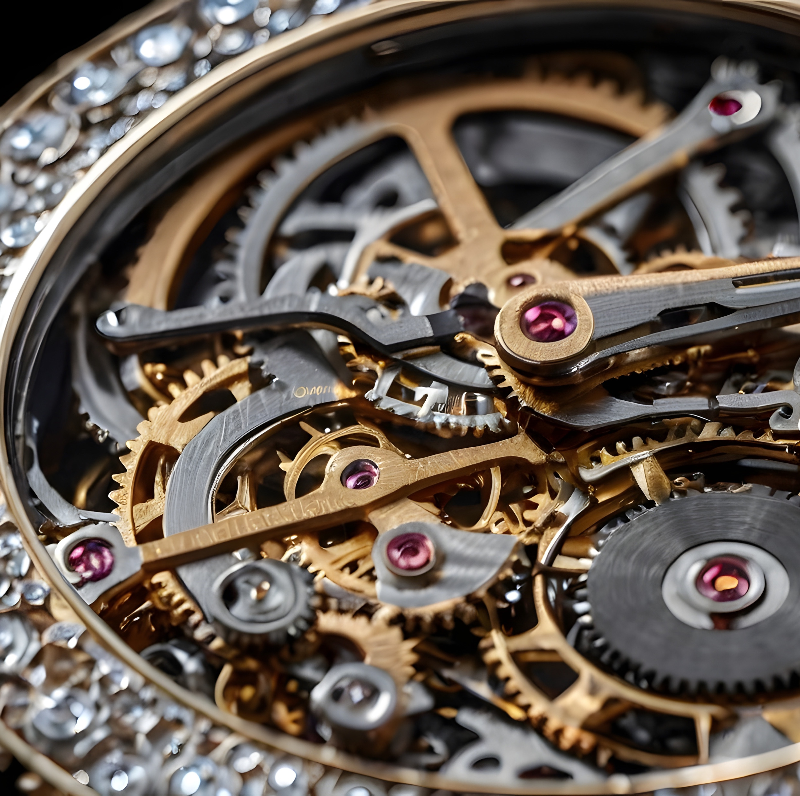
Digging further into LLM and HF
Dr Maria Prokofieva

Slide 2
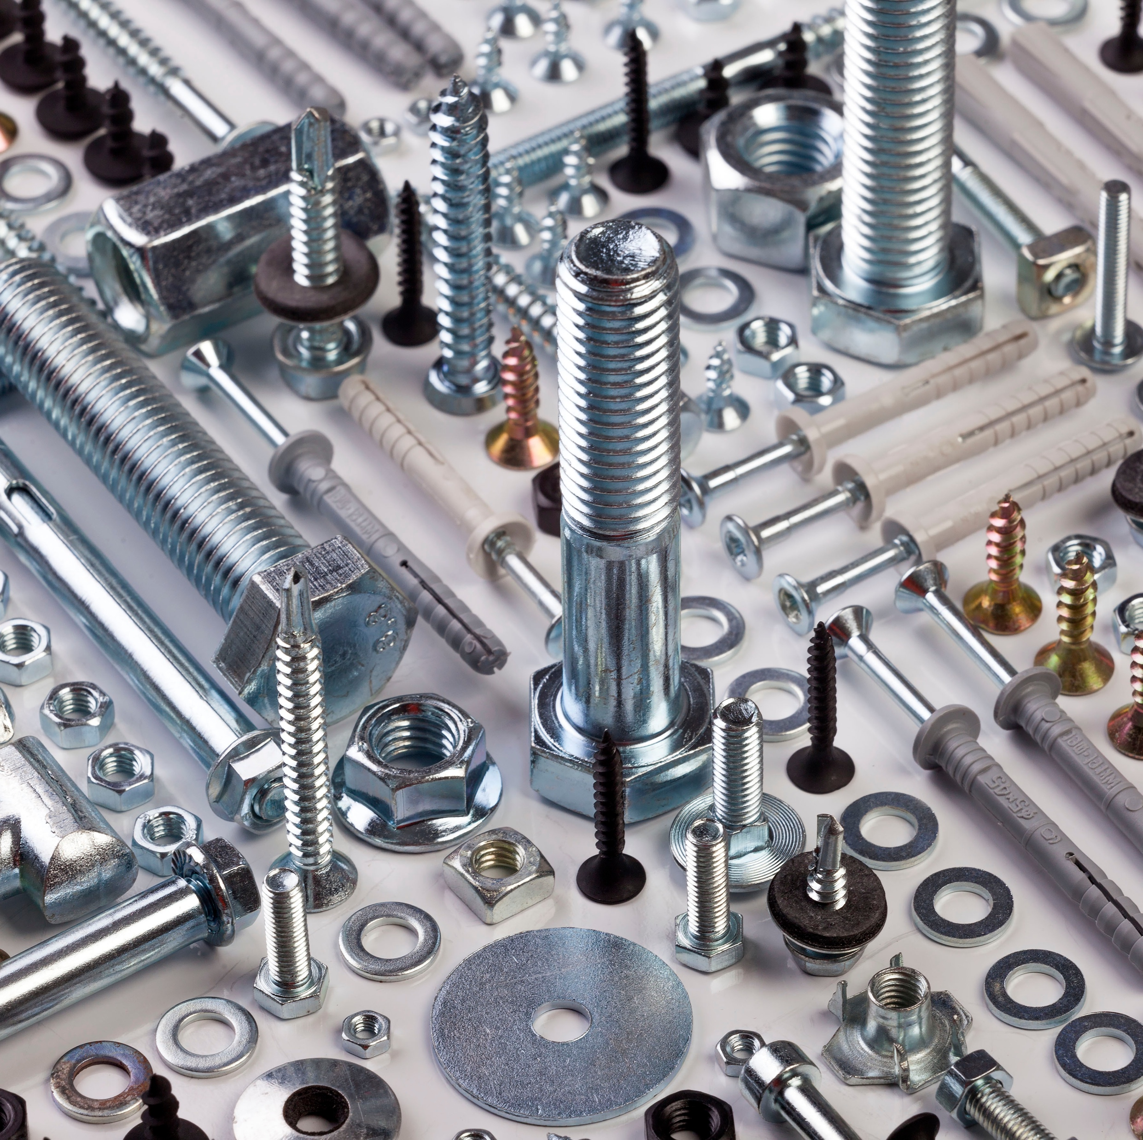
What we will cover
Data preprocessing
Encoding
Tokenization
Models
Notes:
Nuts and bolts of Hugging Face

Slide 3
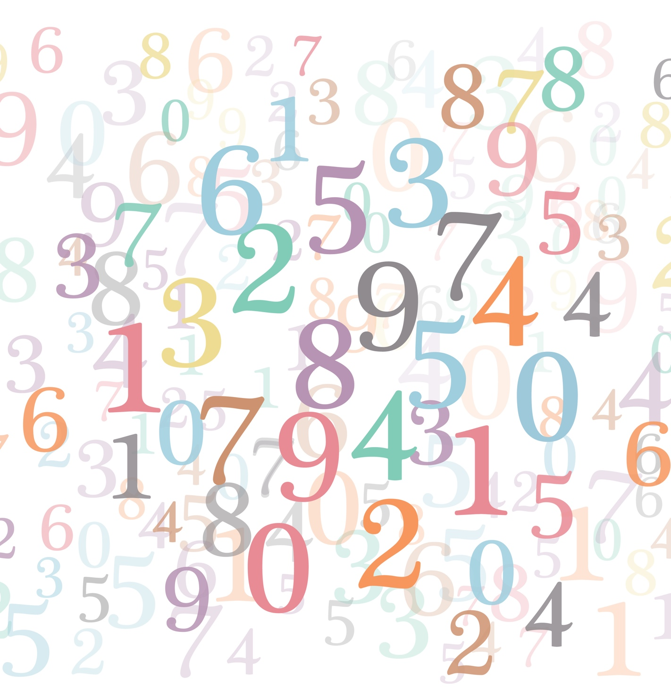
Encoding
Translating text to numbers
Steps:
Tokenization
Conversion of tokens to input IDs

Slide 4
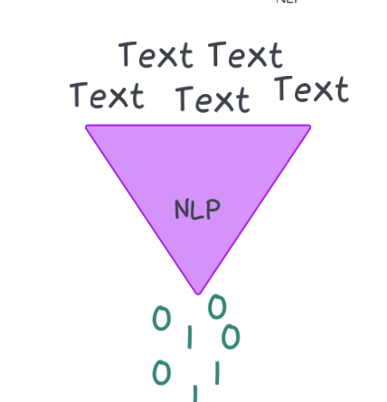
Tokenization
Problem: Models work with numbers, but input is a text
Tokenizers: translate text into data that can be processed by the model
convert our text inputs to numerical data
Tokenization
Splitting Text: into tokens.
"Hello, world!" > ["Hello", ",", "world", "!"]
Subword Tokenization: words are split into smaller units.
"unhappiness" > ["un", "##happiness"]

Slide 5
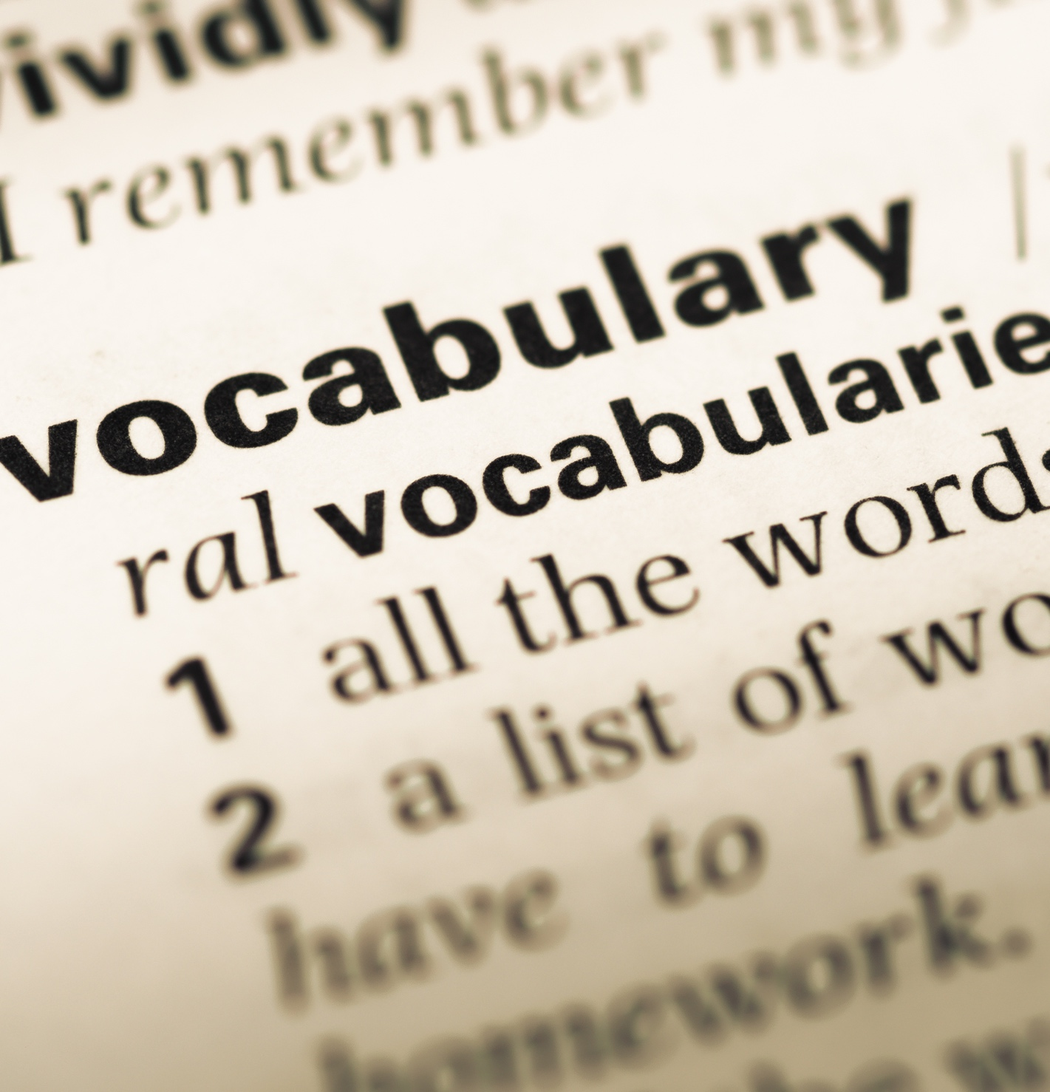
Mapping Tokens to IDs
Vocabulary: Each token is mapped to a unique numerical ID based on a pre-defined vocabulary.
Vocabulary = a dictionary of all the tokens the model understands.
"Hello" > ID 1234, "world" > 5678
Special Tokens: Tokenizers add special tokens required by the model, such as:
[CLS]: Marks the beginning of a sentence (used by models like BERT).
[SEP]: Separates sentences in tasks that involve multiple sentences.
[PAD]: Used to pad sequences to the same length in a batch.

Slide 6
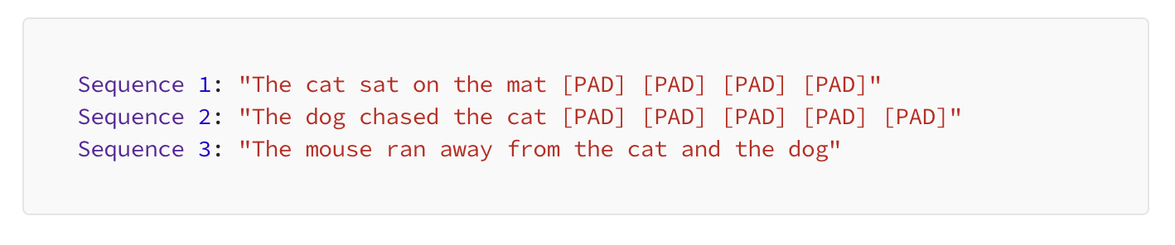
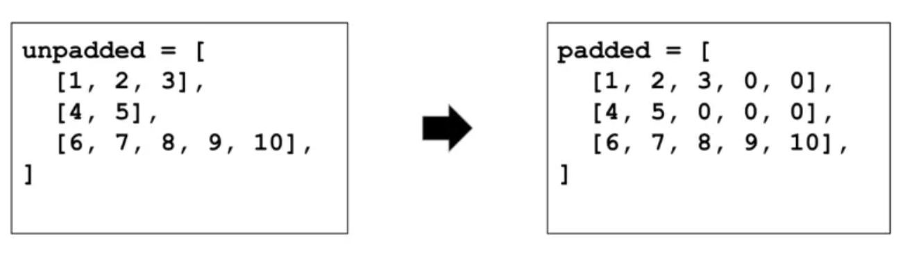
Handling Different Sequences
Problem: Batched inputs are often different lengths, so they can’t be converted to fixed-size tensors
Padding: Tokenizers can pad sequences to ensure they are all the same length, which is necessary for batch processing.
Truncation: If a sequence is too long, tokenizers can truncate it to a maximum length, ensuring it fits within the model's input constraints.

Slide 7

Converting Back to Text
Detokenization:
the output tokens can be converted back to human-readable text. This is useful for tasks like text generation or translation.

Slide 8
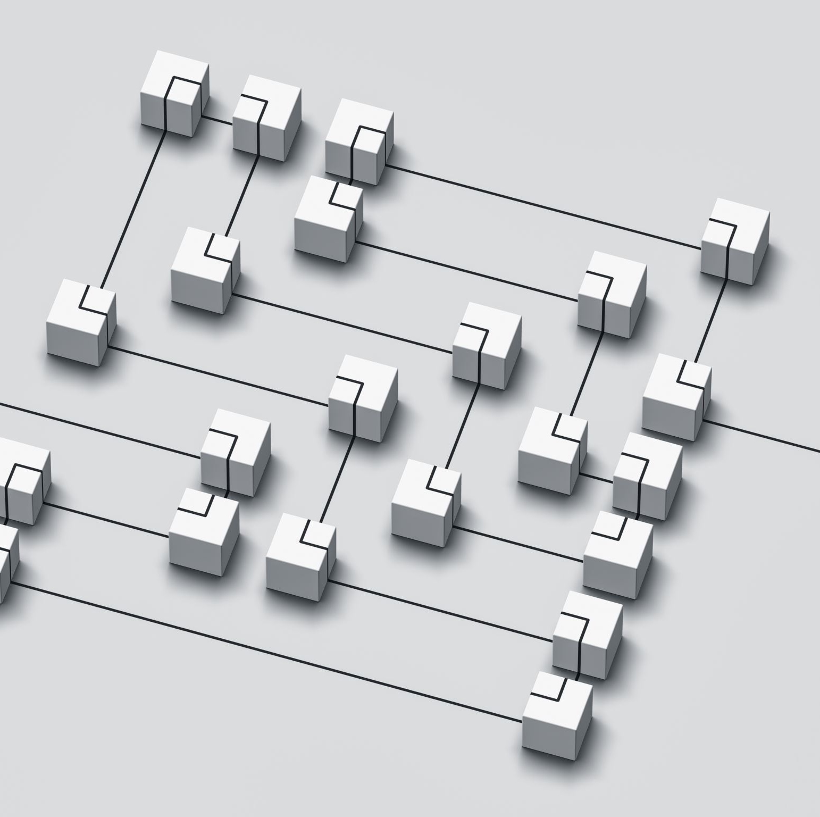
Handling multiple sequences
Batching is the act of sending multiple sentences through the model, all at once.
Multiple inputs are grouped together as a single batch and processed in parallel by the model.
GPUs or TPUs are designed to handle parallel computations efficiently.
Why?
Efficiency
Resource Utilization
Consistency
Notes:
Batching is the process of grouping multiple inputs together into a single batch so that they can be processed in parallel by the model. This is particularly useful when working with GPUs or TPUs, which are designed to handle parallel computations efficiently. By processing a batch of sentences at once, you can significantly reduce the time it takes to generate embeddings or perform other model operations compared to processing each sentence individually.
Why Use Batching?
Efficiency: Batching allows the model to process multiple sentences in parallel, leveraging the computational power of GPUs or TPUs, leading to faster processing times.
Resource Utilization: It optimizes the usage of hardware resources, reducing the idle time of processing units and improving throughput.
Consistency: Batching ensures that sentences are processed together, maintaining consistency in processing, which is important when the outputs (e.g., embeddings) are used together in downstream tasks.

Slide 9

Creating Attention Masks
Attention masks:
Required to indicate which tokens in the sequence should be attended to by the model.
This is particularly important because some tokens in the batch may be padding tokens, which should be ignored during processing.
The model uses these masks to focus on the meaningful tokens and ignore the padding.

Slide 10
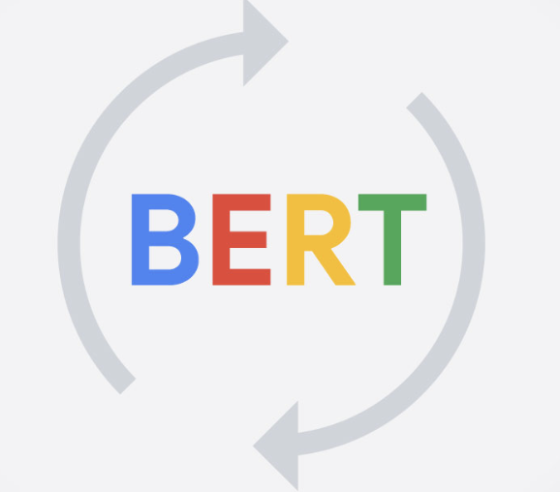
BERT
Bidirectional Encoder Representations from Transformers (encoder only)
Use Case: Text classification, named entity recognition (NER), question answering, text summarization
Bidirectional: “understand” words in a context by considering both the left and the right of a given word.
Pretraining Tasks
Masked Language Modeling (MLM): predict these masked tokens
Next Sentence Prediction (NSP): predict if the second sentence follows the first one in the original text
https://huggingface.co/docs/transformers/en/model_doc/bert
Notes:
Architecture
Transformer Model: BERT is based on the Transformer architecture, which relies on self-attention mechanisms to process words in a sentence relative to each other, regardless of their position. This is a significant departure from previous models that processed text sequentially.
Bidirectional: Unlike previous models like GPT (which is unidirectional), BERT reads text bidirectionally, meaning it considers the context from both the left and the right of a given word. This allows BERT to better understand the meaning of words in context, which is crucial for many NLP tasks.
Pretraining Tasks
BERT was pretrained on two specific tasks that enable it to develop a deep understanding of language:
Masked Language Modeling (MLM): During pretraining, some percentage of the input tokens are randomly masked, and BERT's goal is to predict these masked tokens. This forces the model to learn how words relate to each other in context.
Next Sentence Prediction (NSP): BERT is trained to understand the relationship between two sentences. It is given pairs of sentences and must predict whether the second sentence follows the first one in the original text. This helps BERT understand sentence-level relationships.
Applications
BERT has been widely adopted for various NLP tasks:
Text Classification: BERT is fine-tuned to classify texts into categories such as sentiment (positive, negative) or topics (sports, politics).
Named Entity Recognition (NER): BERT can be used to identify entities like names, locations, and organizations in a text.
Question Answering: BERT can understand a passage of text and find the span of text that answers a given question.
Text Summarization: BERT can be adapted to create summaries of long documents by understanding the main points.

Slide 11
Variants of BERT
RoBERTa: A version of BERT with an improved training procedure that results in better performance on downstream tasks.
DistilBERT: A smaller, faster, and lighter version of BERT
ALBERT (A Lite BERT): A version of BERT that reduces model size by sharing parameters across layers
Notes:
RoBERTa: A version of BERT with an improved training procedure that results in better performance on downstream tasks.
DistilBERT: A smaller, faster, and lighter version of BERT that retains most of its performance but with fewer parameters, making it more suitable for deployment.
ALBERT (A Lite BERT): A version of BERT that reduces model size by sharing parameters across layers, making it more efficient without sacrificing too much accuracy.
Variants of BERT
Since its release, several variants of BERT have been developed to address different needs:
RoBERTa: A version of BERT with an improved training procedure that results in better performance on downstream tasks.
DistilBERT: A smaller, faster, and lighter version of BERT that retains most of its performance but with fewer parameters, making it more suitable for deployment.
ALBERT (A Lite BERT): A version of BERT that reduces model size by sharing parameters across layers, making it more efficient without sacrificing too much accuracy.

Slide 12
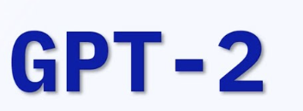
GPT-2
Generative Pre-trained Transformer 2 (decoder only)
Use Case: Text generation, language modeling, creative writing.
Unidirectional: Unlike BERT, unidirectional:
predicts the next word in a sequence based solely on the preceding words
Pretraining Tasks:
Large-scale Pretraining (8 million of web pages)
Zero-shot Learning (not trained specifically)
Very versatile , but lack specificity, ”biased”
https://huggingface.co/openai-community/gpt2
Notes:
Architecture
Transformer Model: GPT-2 is based on the Transformer architecture, specifically using the decoder portion of the Transformer. This architecture uses self-attention mechanisms to process and generate text, allowing the model to consider the context provided by the input text.
Unidirectional: Unlike BERT, which is bidirectional, GPT-2 processes text in a unidirectional manner, meaning it predicts the next word in a sequence based solely on the preceding words. This makes it particularly effective at generating coherent, contextually relevant text.
Pretraining
Large-scale Pretraining: GPT-2 was pretrained on a massive dataset of 8 million web pages, giving it a broad understanding of language, facts, and context. The model learns to predict the next word in a sentence, which helps it generate fluent and contextually appropriate text.
Zero-shot Learning: During pretraining, GPT-2 was not specifically trained for particular tasks like translation or summarization. However, it can perform these tasks without additional training (zero-shot), based on its understanding of language from pretraining.
Applications
Creative Writing: GPT-2 can generate stories, poems, dialogues, or any other form of creative writing, making it a tool for writers looking for inspiration or assistance in drafting content.
Chatbots: GPT-2 can be used to build conversational agents that engage users in natural and coherent conversations.
Content Creation: It can help in creating content for blogs, articles, or social media posts by generating drafts or even full pieces based on a brief prompt.
Code Generation: GPT-2 can also be adapted to generate code snippets or provide suggestions in programming, although GPT-3 and later models are more commonly used for this purpose.
Language Translation: While not specifically trained for translation, GPT-2 can generate translations by providing it with a prompt that suggests a translation task.
Summarization: By providing a prompt that asks for a summary, GPT-2 can generate summaries of longer texts, though models like T5 and BART are often better suited for this task.
Strengths
Versatility: GPT-2’s ability to handle a wide range of tasks without task-specific training makes it extremely versatile.
Fluency: The model generates text that is fluent and contextually appropriate, often indistinguishable from text written by humans.
Limitations
Lack of Specificity: Because GPT-2 wasn’t trained on specific tasks, it may not always produce accurate or task-optimized outputs (e.g., translations or summaries might not be as precise as those from models specifically trained for these tasks).
Bias: Like many large-scale language models, GPT-2 can reflect biases present in the training data, potentially generating biased or inappropriate content.
Compute Intensive: The larger versions of GPT-2 require substantial computational resources for both training and inference.

Slide 13
T5
Text-To-Text Transfer Transformer (encoder-decoder)
Use Case: Text generation, summarization, translation, and more.
Text-to-Text Framework: input and output are always text strings, regardless of the specific task
Pretraining
Massive Pretraining Corpus: pretrained on the C4 dataset (Colossal Clean Crawled Corpus), which contains hundreds of gigabytes of cleaned text data from the web
Self-Supervised Learning: "span corruption," where a portion of the input text is masked out, and T5 is tasked with generating the missing spans of text
Resource-Intensive
https://huggingface.co/docs/transformers/en/model_doc/t5
Notes:
T5, or Text-To-Text Transfer Transformer, is a versatile and powerful language model developed by Google Research, which is part of their larger exploration into the capabilities of transformers in NLP.
T5 stands out for its unique approach to NLP tasks, where it frames all tasks as a text-to-text problem. This means that both the input and output are always text strings, regardless of the specific task, making the model incredibly flexible.
1. Text-to-Text Framework
Unified Approach: Unlike models that are specialized for specific tasks (e.g., BERT for classification and GPT-2 for text generation), T5 treats every problem as a text generation problem. For example:
Text Classification: Input might be "classify: This movie was amazing" with an output of "positive."
Translation: Input could be "translate English to French: The book is on the table" with an output of "Le livre est sur la table."
Summarization: Input might be "summarize: The quick brown fox jumps over the lazy dog." with an output of a shortened version.
Task Prefixes: T5 uses prefixes to specify the task at hand, such as "translate English to French:" or "summarize:", which tells the model what type of output is expected.
Architecture
Transformer-Based: T5 is built on the standard Transformer architecture, utilizing both the encoder and decoder stacks. This is different from models like BERT (which only uses the encoder) or GPT-2 (which only uses the decoder).
Scalability: T5 comes in various sizes, ranging from small versions with 60 million parameters to the large version with 11 billion parameters. The larger the model, the better its performance, albeit at the cost of increased computational resources.
Pretraining
Massive Pretraining Corpus: T5 was pretrained on the C4 dataset (Colossal Clean Crawled Corpus), which contains hundreds of gigabytes of cleaned text data from the web. This extensive pretraining allows T5 to learn a wide range of language patterns and facts.
Self-Supervised Learning: The model was trained using a self-supervised objective called "span corruption," where a portion of the input text is masked out, and T5 is tasked with generating the missing spans of text. This helps the model learn to generate text that fits naturally within the context of the input.
Fine-Tuning
Task-Specific Fine-Tuning: After pretraining, T5 can be fine-tuned on specific tasks by providing labeled datasets where both input and output are text. The model then learns to perform the task in a more specialized manner.
Flexibility: The text-to-text framework allows T5 to be fine-tuned for a wide variety of tasks, including translation, summarization, question answering, and more, without changing the model architecture.
Applications
Text Summarization: T5 can condense long pieces of text into shorter summaries while retaining the essential information.
Machine Translation: T5 can translate text between different languages, making it useful for multilingual applications.
Text Classification: Although traditionally done using models like BERT, T5 can also perform text classification by outputting the appropriate label as text.
Question Answering: T5 can be used to generate answers to questions based on a provided context.
Creative Writing: Like GPT-2, T5 can generate text creatively based on a given prompt, though it is typically used in more structured tasks.
Strengths
Unified Framework: The ability to handle multiple NLP tasks within a single model architecture is one of T5's greatest strengths. This reduces the need for task-specific models and allows for more straightforward transfer learning.
Performance: T5 has achieved state-of-the-art results on several benchmarks, such as the GLUE benchmark for language understanding, showcasing its strong generalization abilities.
Versatility: T5’s text-to-text paradigm is flexible, making it applicable to almost any text-related task.
Limitations
Resource-Intensive: Larger versions of T5 require significant computational resources for both training and inference. This makes it less accessible for those without access to high-end hardware.
Complexity: The model’s general-purpose nature means that it might not always be the most efficient choice for highly specialized tasks where simpler models might suffice.
Interpretability: Like many large language models, T5 can be difficult to interpret, making it challenging to understand why it generates specific outputs.

Slide 14
Bart
Encoder-decoder structure combining BERT-like bidirectional encoding and GPT-like autoregressive decoding.
Use Case: Text summarization, translation, and generation.
Pretraining Task:
"corruption techniques”= the input is modified or "corrupted" and the model is tasked with reconstructing or "denoising" the original, uncorrupted text.
the model learns to generate coherent text even when the input is incomplete or noisy
https://huggingface.co/docs/transformers/en/model_doc/bart

Slide 15

Longformer
Purpose: Designed for efficiently processing long documents, overcoming the limitations of traditional transformers.
Use Cases: document classification, summarization, question answering
Key Features:
Sliding Window Attention: handle sequences with thousands of tokens.
Global Attention: Enables selective focus on important tokens across the entire document.
Scalability: Handles sequences up to 4096 tokens or more, making it suitable for large-scale text analysis.
https://huggingface.co/docs/transformers/en/model_doc/longformer
Notes:
The Longformer is a transformer-based model designed specifically to handle long documents efficiently, overcoming the limitations of traditional transformer models like BERT and GPT, which struggle with long sequences due to their quadratic complexity in the self-attention mechanism. Longformer introduces a more efficient attention mechanism, allowing it to process much longer sequences of text while maintaining computational feasibility.
Key Features and Innovations of Longformer
Self-Attention in Transformers:
In traditional transformers, the self-attention mechanism allows each token in a sequence to attend to every other token. This creates a matrix of size n x n, where n is the number of tokens in the sequence. As n increases, the memory and computation required grow quadratically, making it difficult to process long sequences.
For example, BERT has a maximum input length of 512 tokens, beyond which it cannot process text directly, limiting its use for tasks involving long documents like full-length articles or research papers.
Efficient Attention Mechanism:
Local Attention: Longformer introduces a sliding window attention mechanism where each token attends to a fixed number of neighboring tokens. This reduces the complexity from quadratic to linear, allowing the model to scale to longer sequences.
Sliding Window: For example, with a window size of 512, each token only attends to its 256 preceding and 256 following tokens, dramatically reducing the computational load.
Global Attention: In addition to local attention, Longformer can apply global attention to specific tokens that are crucial for the task. This allows certain tokens (e.g., the [CLS] token in classification tasks) to attend to all other tokens in the sequence, enabling the model to gather information from across the entire document when necessary.
Scalability:
Longformer can handle sequences much longer than 512 tokens, often extending to thousands of tokens (e.g., 4096 tokens or more). This makes it particularly suited for tasks involving long-form text, such as document classification, summarization, or question answering over long documents.
By efficiently managing the attention mechanism, Longformer maintains performance while scaling to these longer sequences, something that was previously impractical with standard transformers.
Use Cases:
Document Classification: Longformer is ideal for tasks where the entire document needs to be considered, such as classifying legal documents, research papers, or lengthy articles.
Summarization: Longformer can generate summaries of long documents by capturing relevant information spread throughout the text.
Question Answering: For tasks that require understanding long passages of text to find answers, Longformer can efficiently process and attend to relevant sections of the document.
Pre-trained Models:
Longformer comes in different pre-trained versions, typically based on the BERT or RoBERTa architectures. These models can be fine-tuned for specific tasks involving long sequences, leveraging the pre-training on large corpora for effective downstream performance.

Slide 16

Let’s practice!

